Slide 1
Legal Services Task Force
Planning Retreat
December 7, 2012

Slide 2
Agenda
Introductions
Purpose/Objectives
Review of Issue and Key Stats
Review Results and Themes of Interviews
Analysis and Discussion
Breakout Group Exercise
Developing an Effective Delivery System
Effectively Managing Financial Pressures
Raising Community Awareness
Next Steps

Slide 3
Legal Services Task Force - Members
Robert Woods, Chair
Patrick Ball, Facilitator
Sharon Browning, Consultant
Victoria Connor
Suzanne Smith
Carolyn Steinhauser
Honorable John Uhler
Rick Azzaro
Bill Gierasch
Note: members in bold constitute the Executive Committee
Suzanne Greist
Doug Hoke
Wanda Noll
Tom O’Shea
Bob Pullo
Rhodia Thomas
Craig Trebilcock
Mary Weaver
Kristen Woolley
Larry Young

Slide 4
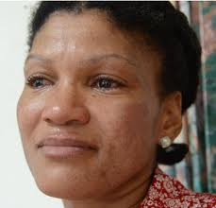
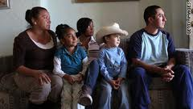
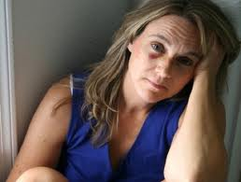
Issue Definition
Financial Pressures
Severe reduction of IOLTA funding
Year over year LSC funding reductions
Year over year State funding reduced
Increased need
Political issue
Shifts in poverty
Funding is inconsistent
Less pro bono participation by new attorneys
Stressed Delivery System
System overloaded
Handoffs not efficient
Some get “lost in system”
Underutilization of technology
Inadequate pro bono referral system
Antiquated model
Adequacy of civil legal services to low income and vulnerable persons, including citizens and non-citizens
Community Awareness
Legislators are not aware of scope
Employers not aware of total effects or resources available
Community not aware
Lack of empathy

Slide 5
Key Stats and Trends
Poverty is growing in York County:
11.1% of the population (48,481 adults and children) are living in poverty.
This is a 23% increase from 2010 and a 21% increase over the 2009 statistics.
Availability of Civil Legal Services:
50,000 people are eligible for civil legal services in York County. Although in Pennsylvania there is one lawyer available for every 232 persons, MidPenn, the local legal service provider for low income people, has only one attorney for every 12,900 eligible individuals.
In the first 9 months of 2012, MidPenn attorneys provided representation in 627 cases. Partnership with the York County Bar Association's Pro Bono Program resulted in an additional 194 cases handled by 62 pro bono attorneys, for a total of 821 cases.
Cases fall into one of four main categories; 1) family law 2) housing and homeless prevention; 3) public benefits; and 4) and consumer law.
In addition, an average of 800 undocumented individuals are housed at the York County Prison. The County receives $83.60 per diem for each individual, and expects that this population will increase by 120 persons within the next year. Legal education and outreach services to many as well as legal representation of a very small number of these individuals is provided by the Pennsylvania Immigration Resource Center.

Slide 6
Key Stats and Trends (cont’d)
Reduction in Funding for Legal Services:
Beginning with the decline in interest rates in 2008, MidPenn and other legal service providers have experienced a drastic and ongoing loss of funding.
IOLTA: based on interest on lawyers trust accounts, reduced from over $2 million annually to under $300,000.
Legal Services Corporation funding reduced:
4% in 2011
15% in 2012
At least 9% projected in 2013
State funding reductions:
10% in 2011
10% in 2012
Further reductions projected in 2014 U.S. Census Bureau's 2011 American Community Survey
Individuals are eligible for free civil legal services if their income is under 125% of the federal poverty rate.

Slide 7
Additional Input - Interviews
Judge Cook
Judge Linebaugh
Judge Renn
Judge Trebilcock
Magistrate Nixon
Magistrate Williams
Deb Loucks, CPC
Penny Myers, York Area Housing Group
Mary Weaver, PIRC
Ashley Grim, PIRC
Ben Hooper, Mid Penn
Rhodia Thomas, Mid Penn
Joseph Coleman, Client
Caty Houtman, Public Defender
Ann Marie McElwee, Attorney
Sandy Ballard, Dauphin County Bar Association
Missy Gosnell, CPC
Marcella Kinard, Bell Socialization
Wanda Noll, York County Human Services
Bill Yanavitch, Glatfelter
Jenny Englerth, FFH
Deana Keifer, YCBA
Steve Snell, RAYAC
Pamela Funk, Tighe Industries
Angus Love, PA Institutional Law Project
Susan Emmons, DA’s office
Joseph Gothie, Attorney

Slide 8
Themes – What did we learn?
The system for accessing and delivering civil legal services to the poorest residents of York County is overwhelmed, dysfunctional, disorganized and ineffective…it is broken!
“many folks spend their lives chasing benefits and help which prevent them from becoming stable”
Adding to the dysfunction is not enough communication between stakeholders.
There is low enthusiasm and participation for pro bono activities across the attorney base in York County.
Mid Penn has issues with capacity, consistently defining their niche, customer service and community awareness.
Although we did hear on more than one occasion that when the need is emergent or the situation particularly severe, Mid Penn has stepped up and been effective.
Top priorities are Family Law, Domestic Violence and Housing…order changes depending who you talk to.
We are fighting ourselves…Bar/Mid Penn….Mid Penn/Housing Authority.
It is possible to fix this – Dauphin and Lebanon counties have made significant improvements in addressing the need.
Many providers in the community would like to provide support in one form or another: CPC, FFH, Public Defender’s office, District Magistrates, Library.

Slide 9
Analysis and Discussion

Slide 10
Decrease in LSC funding since 2010 (30 % reduction with more anticipated)

Slide 12
Availability of Lawyers
Private Bar: @500
Non- legal aid-eligible population in York County: 388, 770
1 lawyer per 778 people
(In PA: 1 lawyer per 232 people)
Legal Aid Lawyers: 4
Eligible clients in York County: @50,000
1 lawyer per 12,500 people
Notes:
Total population of York County: 436,770
11.1% of York County residents live below the poverty level (48,481) Eligibility for free civil legal services is 125% of poverty.

Slide 13
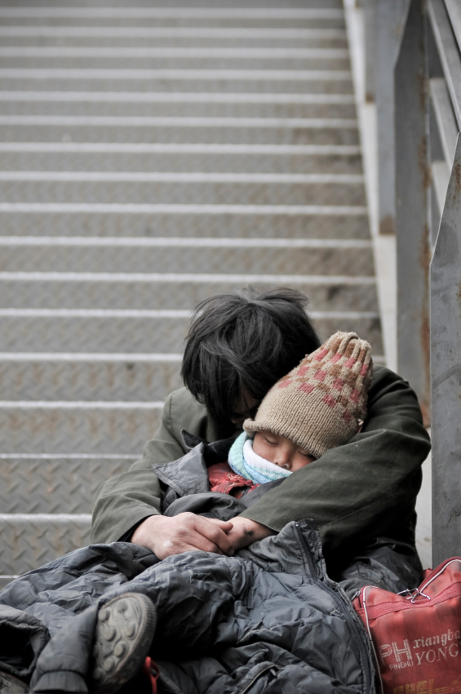
Civil Legal Aid Considerations
The legal emergency room: triage
Vastly under-resourced despite human and social costs/benefits
See PA IOLTA Economic Impact Study
Emerging studies on Qualitative Impact
Tension: Impact work vs. Individual
Representation
Treating symptoms or causes?
The Human dimension
Immersed in the stress of poverty
and trauma
Need for “Trauma Stewardship”

Slide 14
Pro Bono Considerations
Aspirational goal: 50-60 hours per year
Indispensables:
Merit assessment by attorney or equivalent
Careful selection of cases, clients, and projects (realism to avoid “service rationing”
Quality support of pro bono volunteers
Ongoing’ education’ of attorneys, not just training
Standards Compliance and monitoring

Slide 15
Elements of Effective Service Delivery
Effective Service Delivery
Legal Aid: MidPenn & PIRC
Private Bar: Pro Bono
Judiciary

Slide 16
Effective Service delivery….continued Points to Consider
Avoidance of “service rationing”*
Quality legal supervision
Compliance with ABA Standards
Effective and generative communication between the ‘three legs of the stool’
“trauma informed” staff

Slide 17
Breakout Group Discussions

Slide 18
Breakout Group Issue #1
Developing an Effective Delivery System
What unmet needs should be our priorities in York County? For each, consider the following pieces:
What is the optimal role of Mid Penn Legal Services in meeting this need?
What is the optimal role of the YCBA in meeting this need?
Do you see a role for a Court Self Help Center in meeting this need?
What is the optimal role of Community Partners (CPC, District Magistrates, FFH, PIRC, Library) in meeting this need?

Slide 19
Breakout Group Issue #2
Effectively Managing Financial Pressures
Assess the current pro bono culture and capacity in York County’s legal community.
Is there opportunity to add pro bono resources? If so, what process do you recommend for:
Determining what pro bono projects would be best for York County?
Recruiting and educating pro bono attorneys?
What process do you suggest for determining how to allocate resources between MidPenn, Bar efforts and PIRC?
What additional funding sources do we want to explore?
Role of County government?
The business community? What is the business case for someone to invest in this initiative?

Slide 20
Breakout Group Issue #3
Raising Community Awareness
With whom do we need to increase the awareness of this issue?
What strategies might we consider to raise the awareness?
What is the purpose of raising awareness?

