Slide 1


Pro Bono, Civil Legal Aid and Volunteering in Challenging Times
Free legal Answers

Slide 2
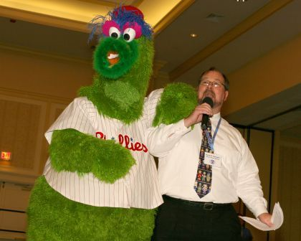
Which One is David?

Slide 3
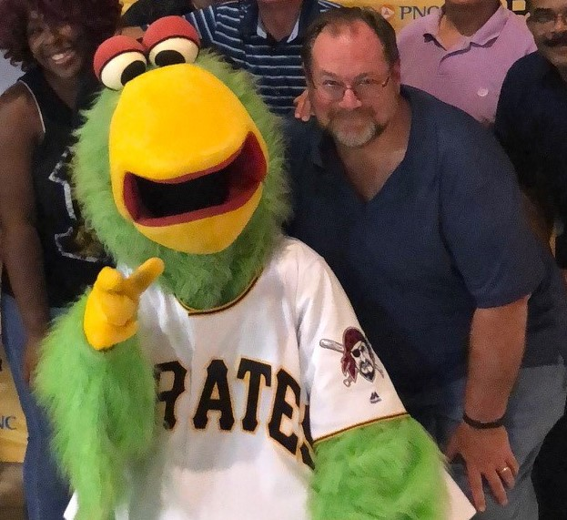
Or is David here?

Slide 4
Agenda
Pro Bono requires a new approach in 2022. This session, featuring Pro Bono Coordinator David Keller Trevaskis, will share a new tool, and highlight some some old tools and new programs, to help volunteer lawyers fulfill the aspiration of Professional Rule of Responsibility 6.1 as we create a new normal after the pandemic.
The COVID-19 crisis impacted our nation in the greatest manner most lawyers have ever experienced, yet the need for legal services for the poor was mitigated by eviction and foreclosure moratoriums, generous unemployment programs and a significant influx of CARES Act funding into our legal aid system. Pro Bono service was impacted by social distancing and circumscribed by the toll exacted by the crisis on attorneys. Moving to the other side of the pandemic, new opportunities arise for law and justice leaders to provide their communities with expanded access to justice.
What is Happening Now in Poverty and Civil legal Aid
The Need for Systems Change…
Keeping up to date with current Programs

Slide 5
PA Rules of Professional Conduct 6.1
Rule 6.1 Voluntary Pro Bono Publico Service
A lawyer should render public interest legal service. A lawyer may discharge this responsibility by providing professional services at no fee or a reduced fee to persons of limited means or to public service or charitable groups or organizations, by service in activities for improving the law, the legal system or the legal profession, and by financial support for organizations that provide legal services to persons of limited means.

Slide 6
PA Rules of Professional Conduct 6.5
Rule 6.5 Nonprofit and Court Appointed Limited Legal Services Programs
(a) A lawyer who, under the auspices of a program sponsored by a nonprofit organization or court, provides short-term limited legal services to a client without expectation by either the lawyer or the client that the lawyer will provide continuing representation in the matter:

Slide 7
Rule 6.5 cont’d
(1) is subject to Rules 1.7 and 1.9(a) [re conflicts involving current or former clients] only if the lawyer knows that the representation of the client involves a conflict of interest; and
(2) is subject to Rule 1.10 [re imputed conflicts] only if the lawyer knows that another lawyer associated with the lawyer in a law firm is disqualified by Rule 1.7 or 1.9(a) with respect to the matter.
(b) Except as provided in paragraph (a)(2), Rule 1.10 is inapplicable to a representation governed by this Rule.

Slide 8
Remember other ethical obligations
Rule 1.1: Competence
Requires the legal knowledge, skill, thoroughness and preparation reasonably necessary
Rule 1.4: Communication
Clear, plain language is important in this setting
Rule 1.6: Confidentiality of information
Response on the platform is seen by client and lawyer who takes the question – not other users;
Lawyer’s obligation to maintain confidentiality

Slide 9


Technology, Pro Bono …The Ethics of it all!
Helping low-income individuals solve legal problems
Brought to you by:
Pennsylvania Legal Aid Network
Pennsylvania Bar Association
Legal Services Corporation
Pro Bono Net
Understand your legal issue,
solve your legal problem

Slide 10

Pennsylvania Lawyers Serving
the Public Good
Brought to you by:
Pennsylvania Legal Aid Network
Pennsylvania Bar Association
Legal Services Corporation
Pro Bono Net

Slide 11

https://pa.freelegalanswers.org
How does Pennsylvania Free Legal Answers work?
Pennsylvania (PBA) Free Legal Answers is based on the walk-in clinic model long employed by the PBA Pro Bono Office at its legal needs clinics where clients request brief advice and counsel about a specific civil legal issue from a volunteer lawyer or a law student or paralegal working under the direction of an attorney volunteer or staffer. Lawyers provide information and basic legal advice without any expectation of long-term representation but there is always the option, if the lawyer wishes to pursue such representation, for the lawyer to take on the client for a fuller pro bono representation.
Users who meet eligibility (see Eligibility below) sign the use agreement, create a password, post a request for legal advice information and provide facts about their case that will help the lawyer answer the question. Users will be asked to select a category (such as “housing” or “debt”) that best describes their question.
Videos and Other Resources for Answering Questions

Slide 12
Free Legal Answers
Overview of Free Legal Answers platform
Income/eligibility screening by PBA
household income < 250% of federal poverty level;
may not have liquid assets exceeding $5,000 in value;
may not be incarcerated and may not request assistance with criminal law matters
Clients on platform sign agreement acknowledging limited scope

Slide 13
Free Legal Answers
Volunteer lawyer can respond and close question or leave it open for follow-up/clarification and then close it
Short-term, limited representation
If you have an interest in further representation, that should be handled through a separate pro bono engagement off the platform (following firm’s or company’s standard conflict check and pro bono file opening process)

Slide 14
ABA Federal free legal answers (for Veterans Benefits and Immigration Law)
ABA Federal Free Legal Answers
General Contact Information
abafederal.freelegalanswers.org/
OTHER
 | ABA Federal Free Legal Answers is a website which allows veterans, along with eligible dependents and survivors, to submit questions about civil legal issues pertaining to veterans, including VA benefits, discharge upgrades, and similar veterans’ legal issues, and receive answers from pro bono lawyers. Visit https://abafederal.freelegalanswers.org/ to get started.

Slide 15
What Else Can Lawyers Do?
In addition to taking advantage of pro bono opportunities like PA Free Legal Answers:
Partner with local legal aid providers
Be concerned about the lack of access to justice
Promote access to justice as a benefit to society as a whole
Let others—friends, representatives, media—know of your concern!
Use banks that offer highest interest on IOLTA accounts and encourage others to become Platinum Leaders!
Donate to Legal Aid

Slide 16
Next Steps
Following this program, if you haven’t done so already, please register on the PA Free Legal Answers platform
No minimum or maximum number of questions or time commitment – select and answer questions at your convenience, from your desk

Slide 17




What's Happening in Pro Bono
That You Should Know!!
Sign up for https://pa.freelegalanswers.org/Attorneys/Account/Agreement
If You Have Pro Bono News—send to dkt@pabar.org
Check out our website for news and more!
http://www.pabar.org/site/Probono
For more Pro Bono Information, call 717-571-7414.

Slide 18
For more information:
David Keller Trevaskis, Esquire
PBA Pro Bono Coordinator
100 South Street
Harrisburg, PA 17101
717-571-7414
dkt@pabar.org

